Slide 1
Combine it! (the functional way)
Munich | 12.10.2018 | Martin Lechner

Slide 2
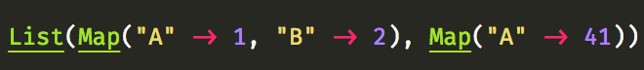
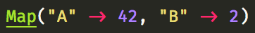
Task: Group this dataset by keys and sum values
Notes:
Let’s start with a common task if you work with data. Think about how you would merge this list of maps, group by key and sum the values.

Slide 3
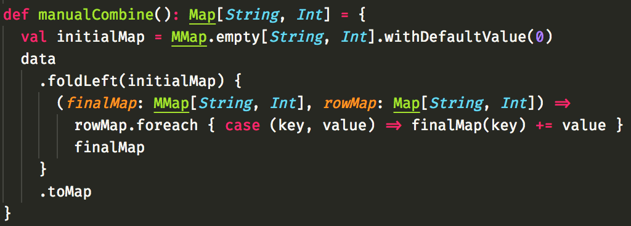
Manually doing this may look like
Notes:
Here we have a simple DIY solution. MMap is a mutable map and its initialized with 0s. Then we fold/reduce the dataset and add the Keys to the Map, summing the value.

Slide 4
The cats way
Notes:
This is the same thing using cats. All you need is an import. Less code to write, less code to maintain… Who prefers this solution?

Slide 5
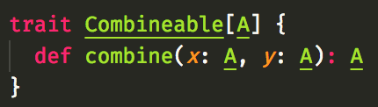
WTF – how is this working ?!?
Notes:
In the following slides we’ll dive a bit into the magic behind this. Let’s have a trait which lets us combine things.

Slide 6
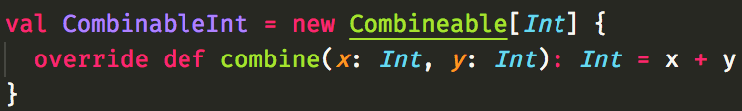
WTF – how is this working ?!?
Notes:
If we want to specify how to combine ints, we can create an Instance of this trait.

Slide 7
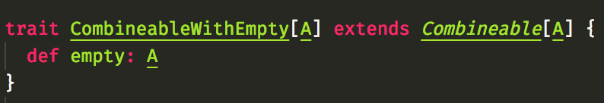
WTF – how is this working ?!?
For folds / reduce it might be useful to have an empty element:
Notes:
Folds usually need empty elements, so let’s extend it for our fold usecase by requiring an empty element. This is basically all we need to know to combine away!

Slide 8
The missing piece: Typeclasses
Typeclasses encapsulate / abstract behavior away from specific type
Usually done with implicits in Scala
You can add the Typeclass behavior by providing typeclass instances
Worth a talk on their own…
Notes:
Combining is some kind of behavior. To encapsulate such behaviors and be able to abstract over all sorts of type we need typeclasses. Those are usually implemented with implicits in scala and worth a talk on their own. Let’s typeclassify what we’ve currently done.

Slide 9
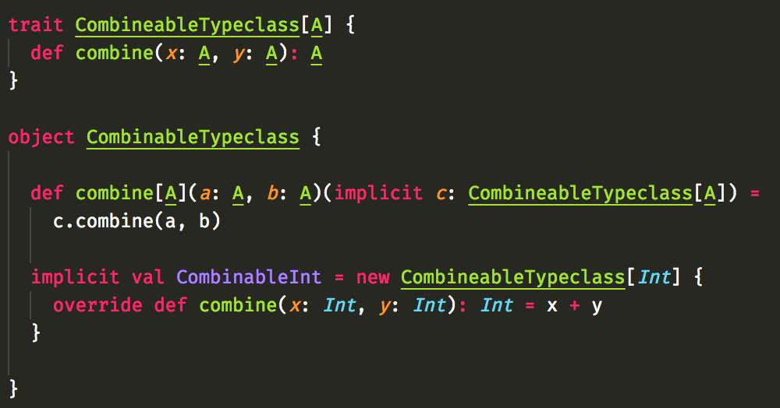
Typeclass example
Notes:
We have the trait again. Then we have acombine method, which requires an implicit instance of the trait. We specify this afterwards. Now we can use combine with ints. If we specify more instances, we can re-use our combine function.

Slide 10
Meanwhile in cats world
Combineable is called Semigroup
|+| is combine
Rule: Associativity:
(a |+| b ) |+| c === a |+| (b |+| c)
CombineableWithEmpty is called Monoid
Additional rule:
a |+| empty === empty |+| a === a
Cats provides default instances for those typeclasses!
List, Map, String, Int, … all covered for free!
Notes:
In Cats the names are slightly different, being taken from category theory. Combineable is called Semigroup and has associviaty.
Combineable with Empty is called Monoid and combining anything with empty returns anything. The good part: The Typeclass instance we’ve just written is provided by cats for us and many more! This is why we didn’t have to write code at all!

Slide 11
Full example with custom ADT
Show code in Intellij
Notes:
I’ll show a simple example how this looks with custom ADTs…

Slide 12
Thank you
Register for the workshop with Luka Jacobowitz, core Maintainer of Cats!

